Slide 1


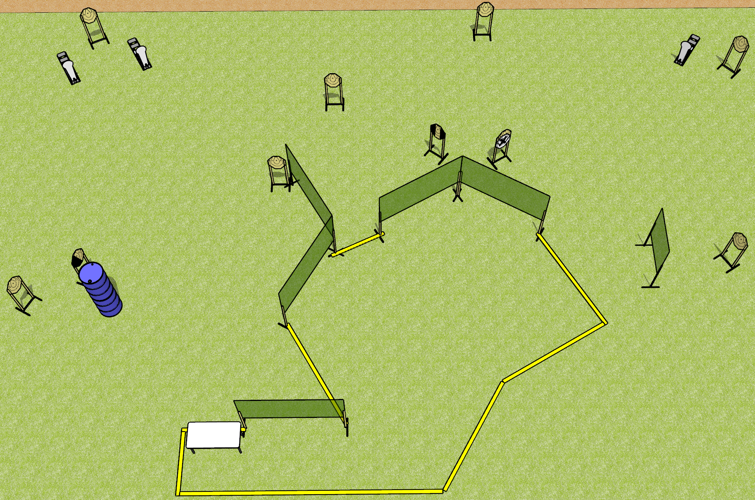
 | Dothan Gun Club – USPSA Match Not Even a Little Course Designer : Drew Coleman Bay: 5
Round Count 23 rounds 10 IPSC 3 colt poppers
Equipment List 12 wall feet Table 1 left, 1 tux 9 targets (8 + 1 NS)

Slide 2
Not Even a Little
Written Stage Briefing
Scoring: Comstock Rounds: 23
Targets: 10 IPSC, 3 steel
Start position: heels touching rear fault line, wrists below belt. Firearm is on table, unpropped, trigger guard over left or right mark. All magazines to be used on stage on table on the opposite side from the gun.
Stage Procedure: on the audible start signal, engage targets as they become available from within the shooting area.

